Slide 1
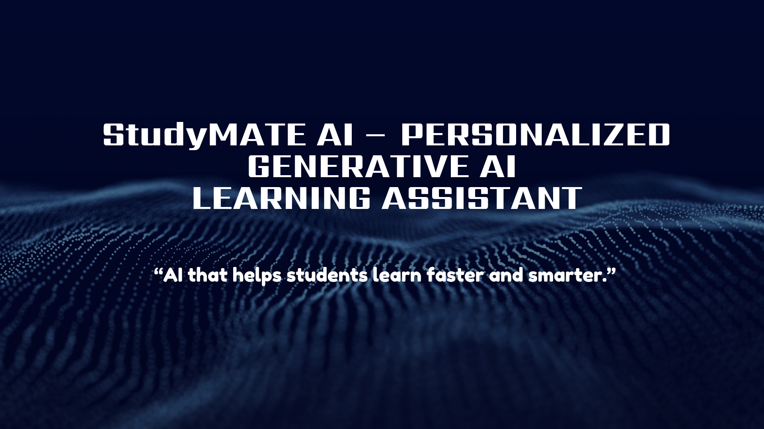
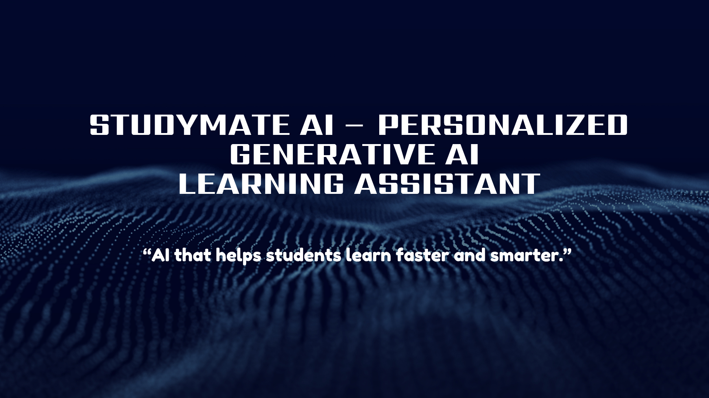

StudyMate AI – Personalized Generative AI Learning Assistant
“AI that helps students learn faster and smarter.”

Slide 2



INTRODUCTION :
■ Study Mate AI is a Generative AI–powered learning assistant designed to help students understand complex study materials more easily. Many students struggle with lengthy textbooks, lecture notes, and difficult programming concepts due to the lack of personalized guidance. Traditional learning platforms often provide the same explanations for all learners, which may not suit different learning levels.
■ Study Mate AI addresses this problem by converting study content into simplified explanations, summaries, quizzes, and flashcards. The system uses generative AI to analyze the input provided by students and generates learning resources tailored to their understanding level—Beginner, Intermediate, or Advanced. By transforming static study material into interactive learning tools, Study Mate AI makes studying faster, more engaging, and more effective for students.

Slide 3



ABSTRACT:
■ Students often struggle to understand complex textbooks, lecture notes, and programming concepts due to a lack of personalized guidance and interactive learning tools. Most existing educational platforms provide static explanations that do not adapt to the learning pace or knowledge level of individual students.
■ Study Mate AI is a Generative AI–powered learning assistant designed to transform traditional study material into personalized and interactive learning experiences. The platform allows students to input lecture notes, textbook content, or academic questions, which are then analyzed using a generative AI model to produce simplified explanations, concise summaries, quizzes, and flashcards.
■ A key feature of Study Mate AI is its Personalized Learning Mode, which adapts explanations according to the student’s learning level—Beginner, Intermediate, or Advanced—ensuring that complex topics are explained in a way that matches the learner’s understanding. The system also includes an AI Quiz Generator and Flashcard Creator to help students revise and test their knowledge efficiently. For programming subjects, Study Mate AI provides step-by-step code explanations, making it easier for students to grasp logic and algorithms.

Slide 4



PROBLEM STATEMENT :
■ Students spend excessive time trying to understand complex textbooks, lecture notes, and programming concepts without personalized guidance . Existing learning platforms deliver static content and fail to adapt explanations to different student learning levels . There is a need for an AI-powered system that converts study material into personalized explanations, summaries, quizzes, and flashcards to make learning faster , interactive, and efficient.
■ Students face major challenges while studying:
• Large and complex textbooks that are difficult for students to understand
• Challenging concepts with limited guidance or explanation
• Time-consuming manual note summarization during study and revision
• Lack of personalized learning support based on individual student needs

Slide 5


Proposed Solution :
• Study Mate AI is an AI learning assistant that helps student study faster and understand topics easily.
• Students can paste notes, upload study material, or ask questions, and the system generates helpful learning tools automatically.
• How AI Helps :
AI reads the content and explains difficult topics in simple words, finds important points, and creates quizzes for practice.
Why It Is Better :
• Saves study time
• Makes learning easier
• Provides personalized learning support

Slide 6

KEY FEATURES:
🔹 AI Concept Explainer
Explains difficult topics in simple language so students can easily understand complex concepts.
🔹 Smart Notes Summarizer
Automatically converts long notes or textbook content into short and clear summaries for quick revision.
🔹 Auto Quiz Generator
Creates practice questions and quizzes from the study material to help students test their knowledge.
🔹 Flashcard Generator
Generates flashcards with important questions and answers to make revision faster and more effective.
🔹 Personalized Learning Mode
Adapts explanations based on the student’s level (Beginner, Intermediate, Advanced) for better learning.

Slide 7


TECHNICAL DETAILS – STUDY AI :
• Study Mate AI is a web-based Generative AI learning platform that transforms raw study materials into personalized educational content.
• Frontend: Built using HTML, CSS, and JavaScript, delivering an intuitive interface where students can upload notes, ask questions, or paste code and select their learning level (Beginner / Intermediate / Advanced).
• Backend: Developed with Python + Flask, handling request processing, prompt engineering, and seamless communication with AI APIs.
• AI Engine: Integrates Generative AI models (OpenAI / Google Gemini) to dynamically generate
simplified explanations, summaries, quizzes, and flashcards in real time.
• Data Layer: A SQLite database stores user inputs, generated responses, and learning history to enable personalized and adaptive learning experiences.

Slide 8


🤖 AI Model Integration :
■ Study Mate AI integrates Generative AI models through APIs such as OpenAI GPT models or Google’s Gemini AI to process and generate educational content.
■ The Flask backend sends user input (notes, questions, or code) to the AI model using an API request. The AI model analyzes the content using Natural Language Processing (NLP) and generates structured outputs such as simplified explanations, summaries, quizzes, and flashcards.
AI Model | Provider | Integration Method | Role in the Project
OpenAI GPT | OpenAI | API Integration through Flask backend | Generates explanations, summaries, quizzes, and flashcards
Google Gemini | Google | API Integration through Python backend | Analyzes study material and provides personalized learning content
Natural Language Processing (NLP) | AI Technique | Built into AI models | Understands text and extracts key concepts from study material

Slide 9

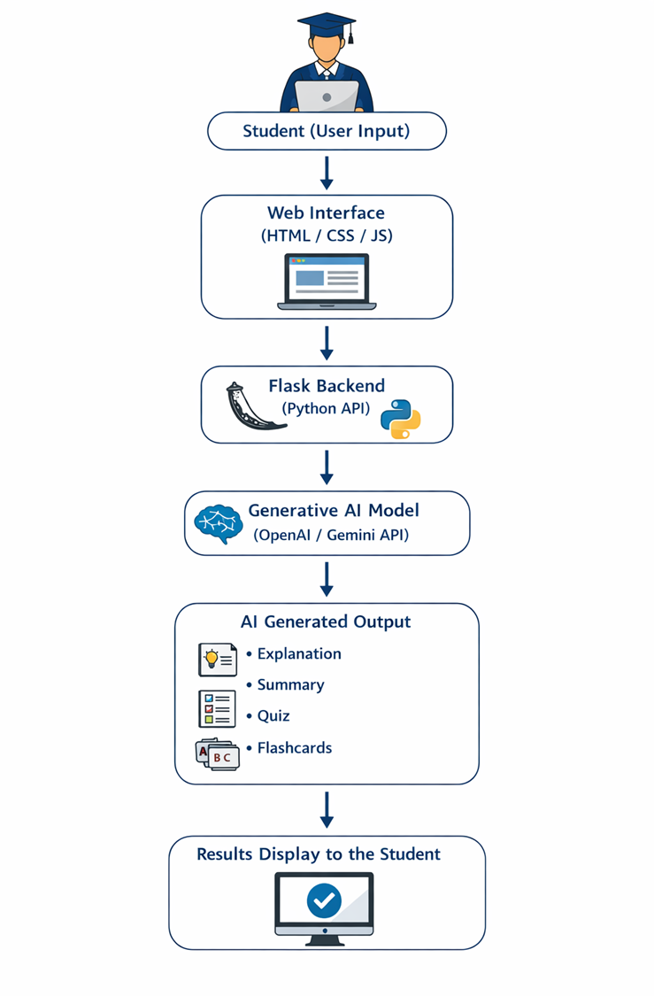

WORKFLOW :
■ The student enters notes, questions, or code in the web interface.
■ The frontend sends the request to the Flask backend.
■ The backend processes the input and sends it to the Generative AI API.
■ The AI model generates explanations, summaries, quizzes, and flashcards.
■ The results are returned and displayed to the student on the interface.

Slide 10

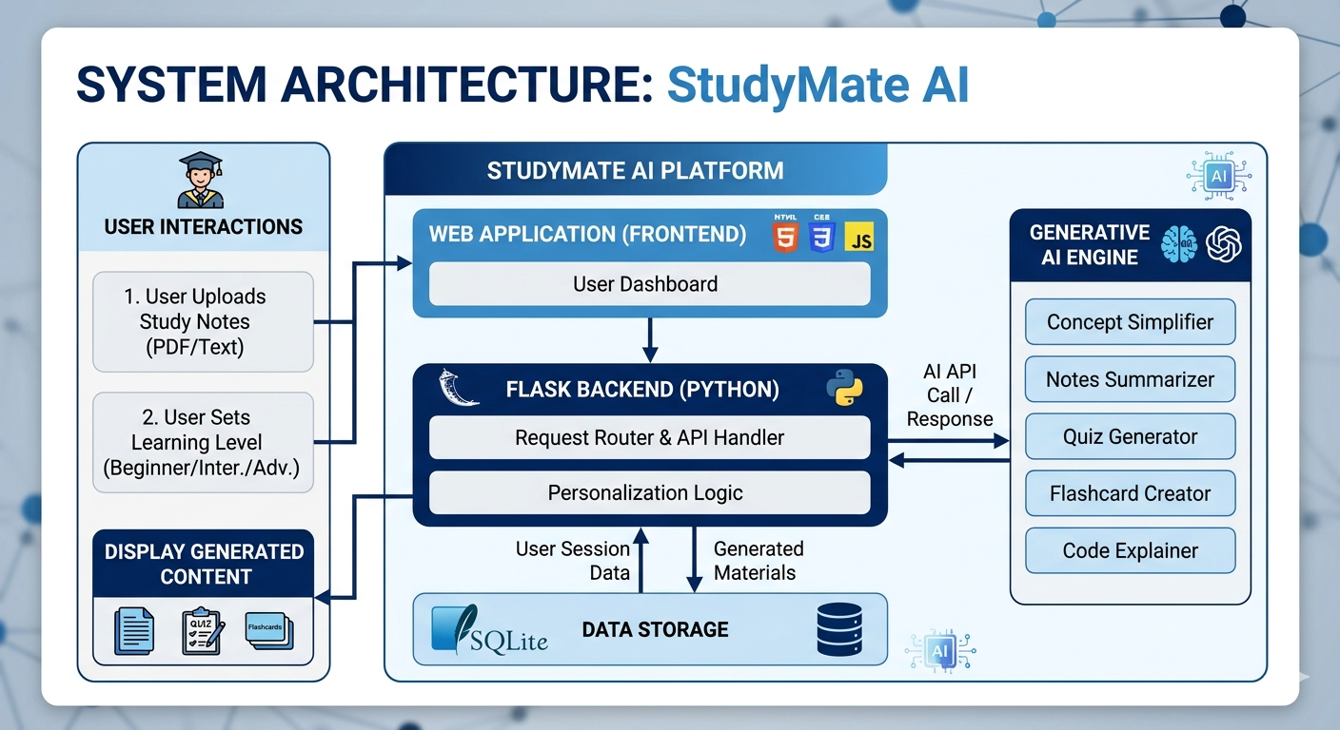

System Architecture :

Slide 11


Real World Impact :
🔹 Who Will Use It
• School and college students
• Online learners and self-learners
• Teachers for creating study materials
🔹 How It Helps
• Makes complex topics easy to understand
• Saves time with AI summaries, quizzes, and flashcards
• Supports personalized and interactive learning
🔹 Market Opportunity
• Growing demand for AI in education
• Can be integrated into schools, colleges, and e-learning platforms
• Supports the future of smart digital learning

Slide 12


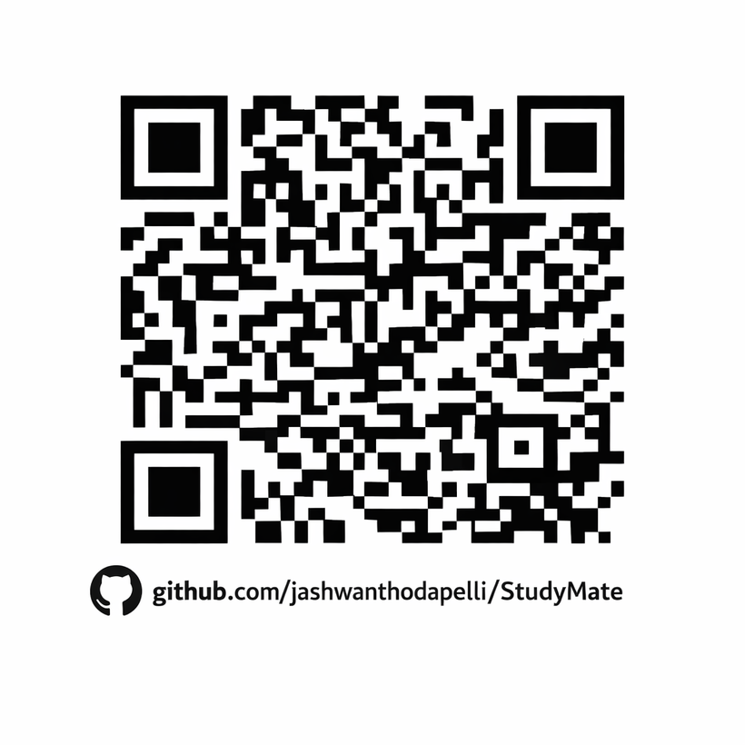
REPOSITORY LINK :
https://github.com/jashwanthodapelli/StudyMate

Slide 13
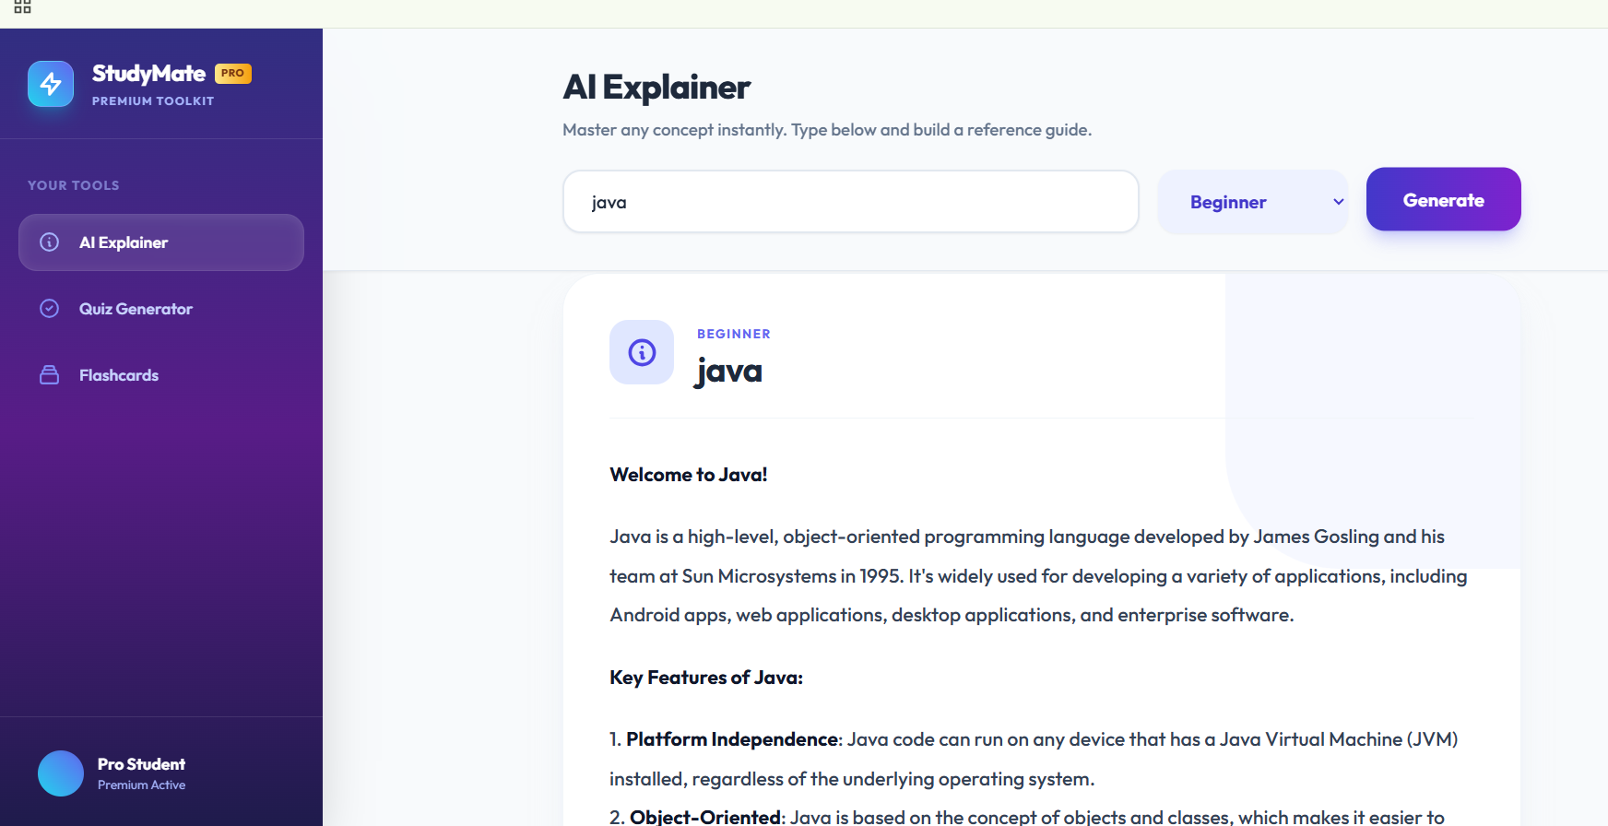
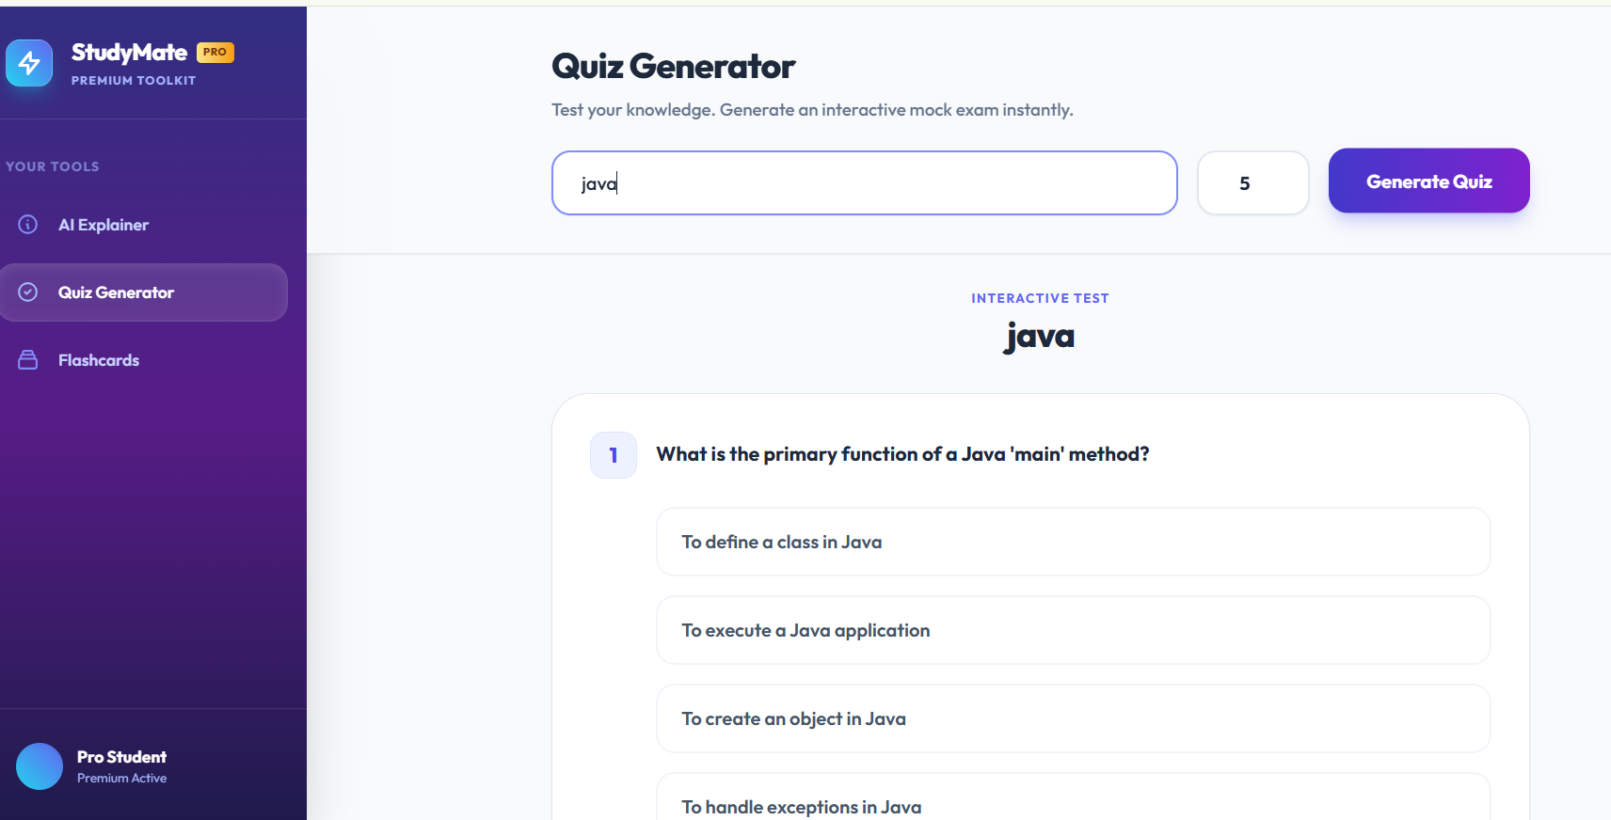
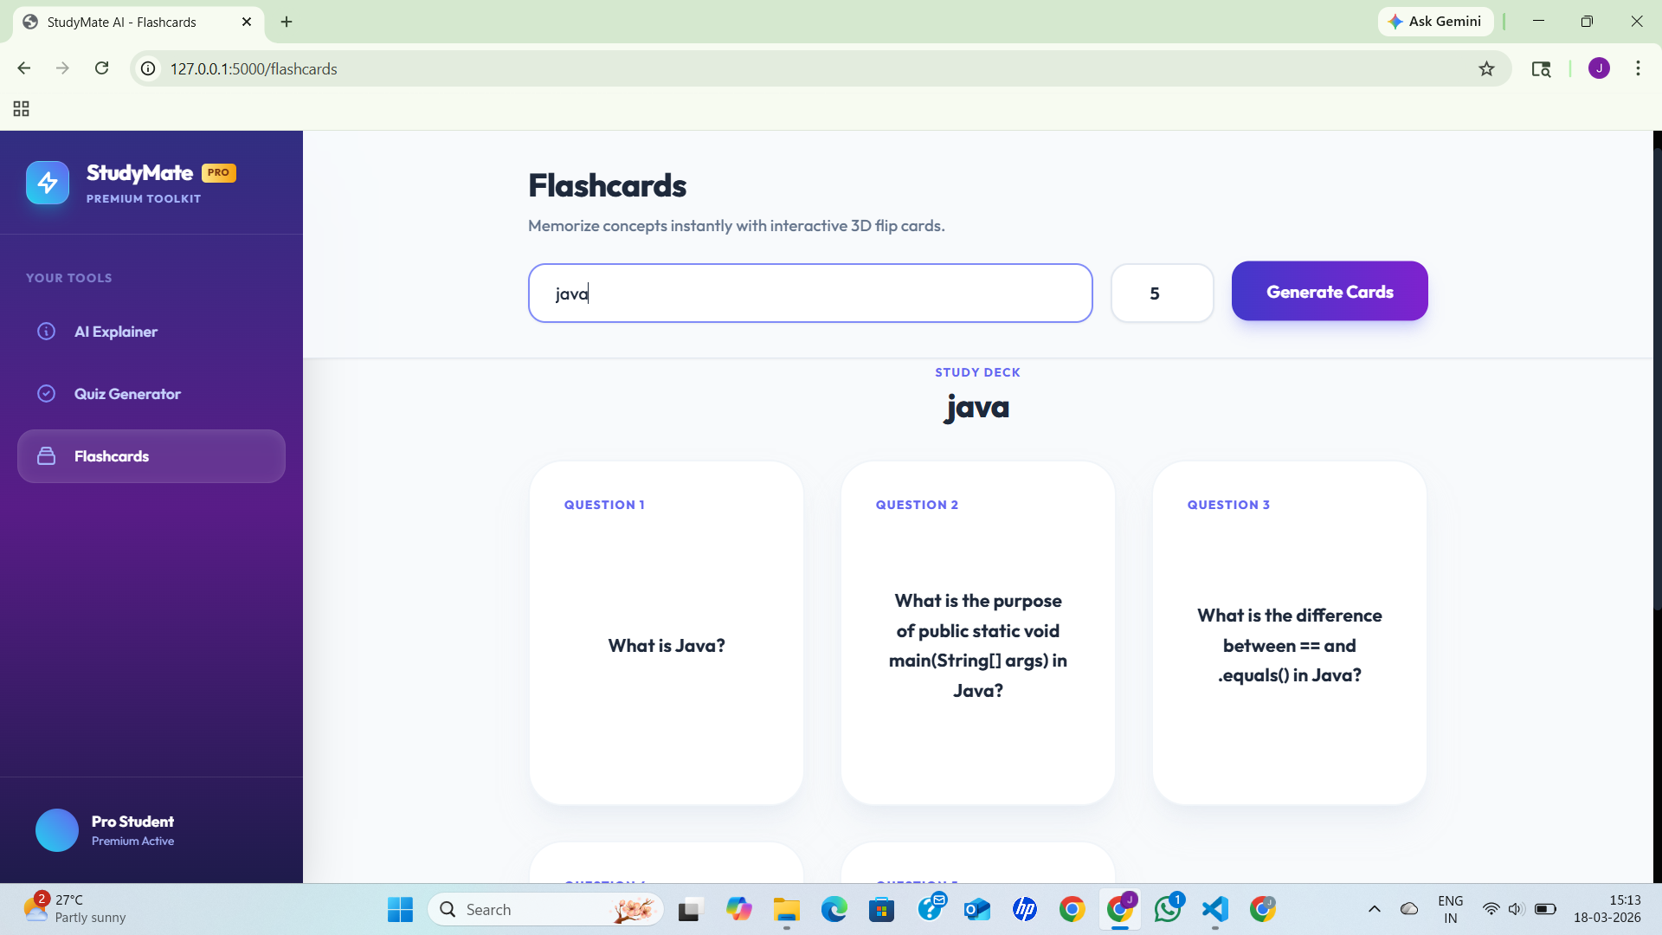
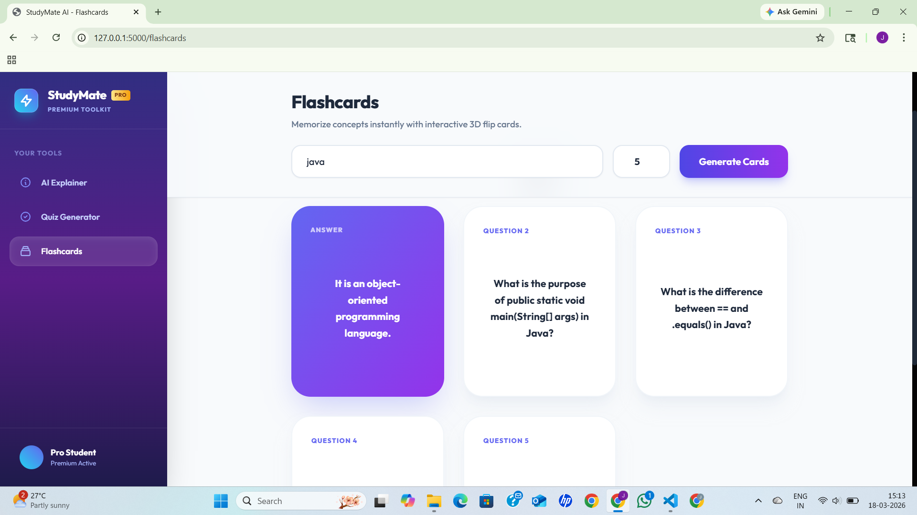

Slide 14
CONCLUSION :
🔹 AI-Powered Learning
Study Mate AI demonstrates how Generative AI can transform traditional studying into an intelligent learning experience.
🔹 Smart Study Assistance
Converts raw study material into summaries, quizzes, flashcards, and explanations to simplify complex topics.
🔹 Faster & Better Understanding
Helps students learn faster, revise efficiently, and improve concept clarity.
🔹 Future of Education
Represents the next step toward personalized AI-driven learning systems.

Slide 15

THANK YOU

